Slide 1


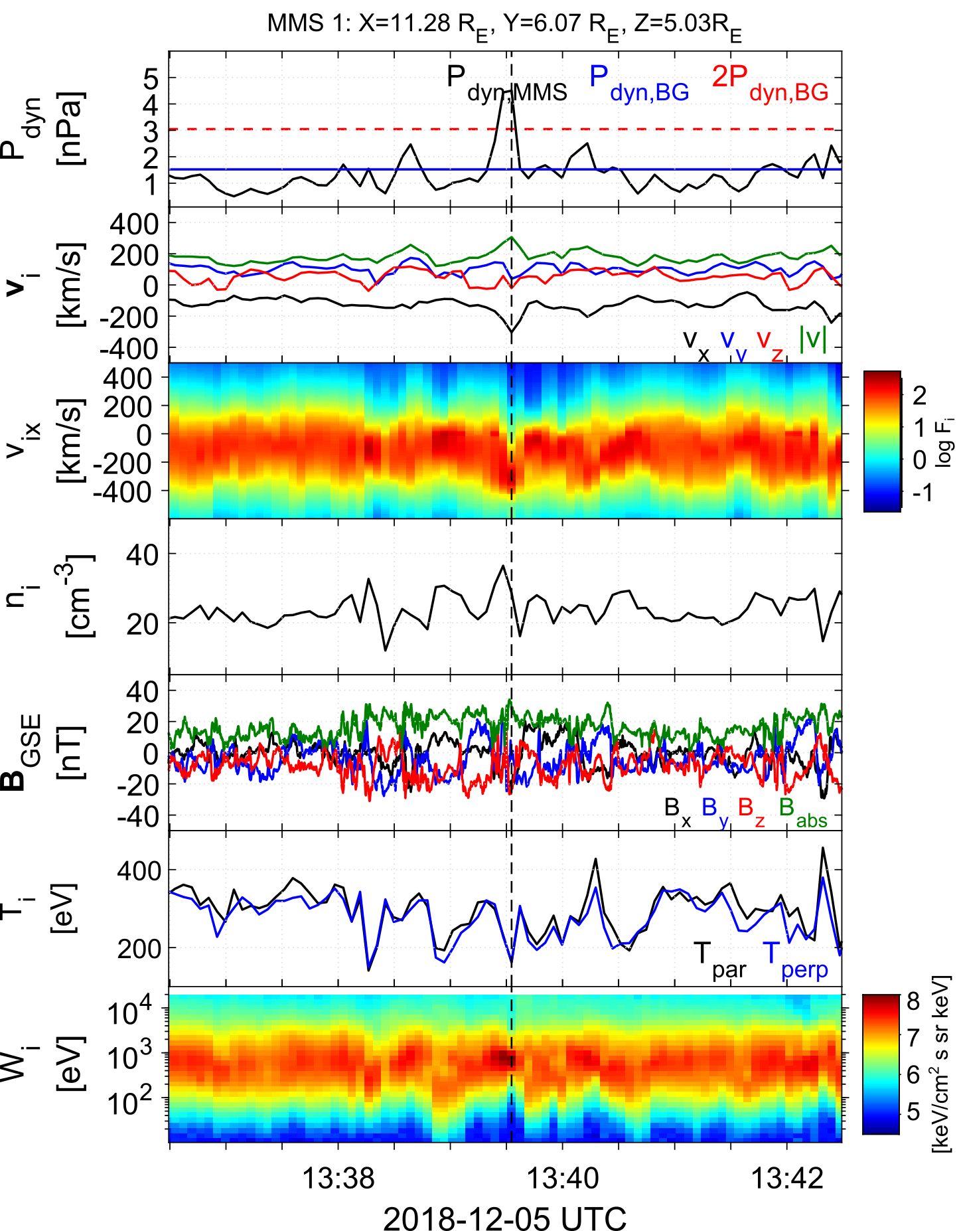
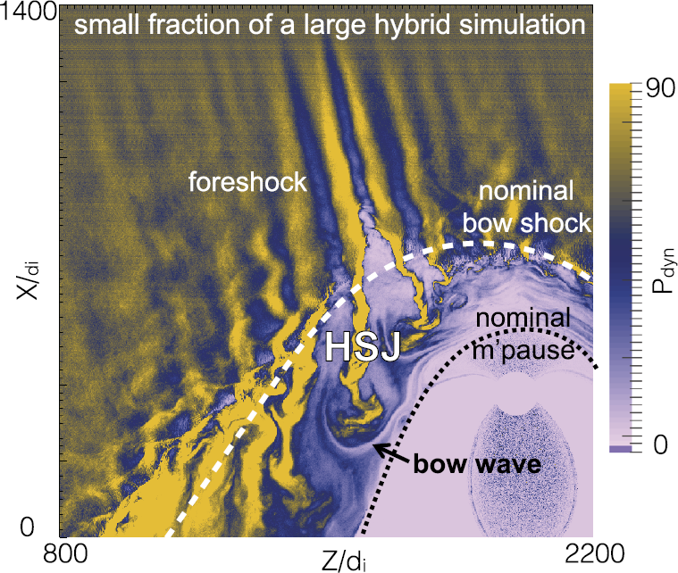
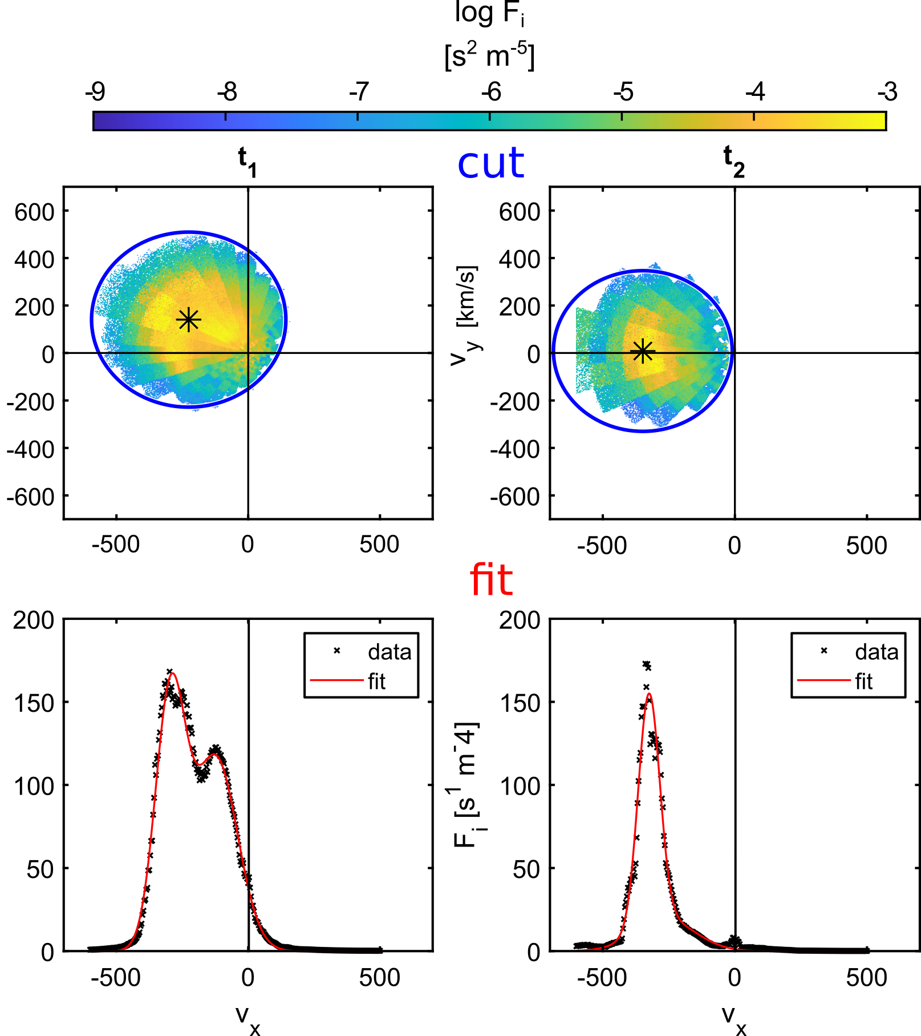
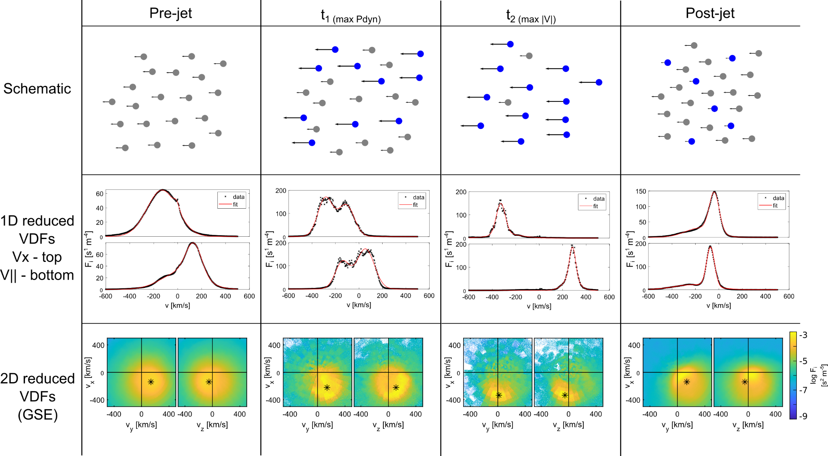
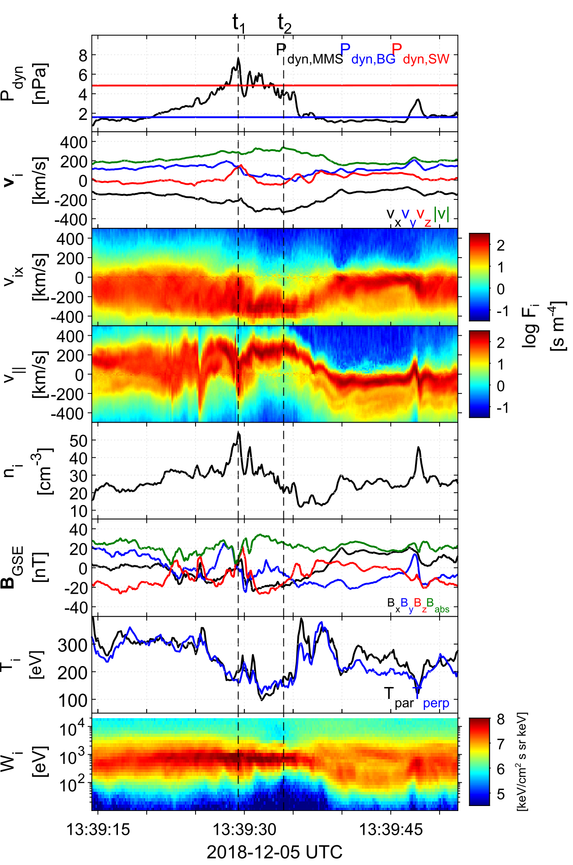
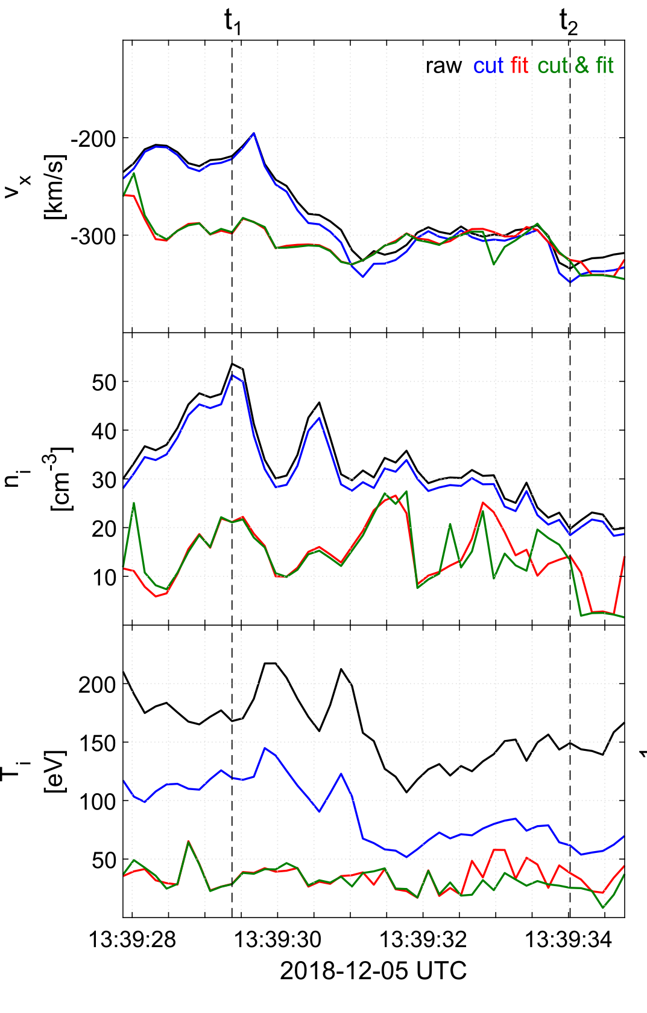



Event
Investigation of magnetosheath jet kinetic structure and plasma moment derivation
Quasi-Parallel Magnetosheath Jets
Fast (low-resolution) data
Savvas Raptis¹, Tomas Karlsson¹, Andris Vaivads¹, Martin Lindberg¹, Andreas Johlander², Henriette Trollvik¹
Dynamic pressure enhancements relative to the background magnetosheath:
$$P_{dyn}≥2{\left\langle P_{dyn}\right\rangle }_{MHS}$$
¹Space and Plasma Physics, KTH Royal Institute of Technology, Stockholm, Sweden, ²Swedish institute of Space Physics, Uppsala, Sweden
“Magnetosheath jets evolve and interact with the background exhibiting non-Maxwellian ion VDFs”
Taken from Karimabadi et al. (2014)
Method
Using NASA’s Magnetospheric Multiscale (MMS) Mission burst (high – resolution) velocity distribution functions (VDFs) to derive partial plasma moments
Cut = remove parts of VDF equal to thermal velocity
Fit = fit two Maxwellians in 1D reduced VDFs
Burst (high-resolution) data
Results
Conclusions & Discussion
Jet partial plasma moments deviate significantly from the full (raw) measured ones.
They exhibit double-peak non-Maxwellian VDFs that can excite waves and highlight a complex interaction with the background MSH
The velocity and density of quasi-parallel magnetosheath jets can be less variable than previously thought indicating a direct connection to the solar wind and its embedded foreshock structures
Read the full article here
Or see
How jets can be formed here
More info: 📧 savvasraptis@gmail.com | 🔗 savvasraptis.github.io

